Slide 1
Communicating Results
Data Science for Beginners, Session 4

Slide 2
Session 3 (Acquiring Data) recap
Finding development data
Data filetypes
Using an API
PDF scrapers
Web Scrapers
Getting data ready for science
Notes:
Here’s what we did last time. Normally at this point in the data science process, we’d start exploring the data, getting rough statistics and creating quick-and-dirty visualisations of it before using it, then communicating our results to an audience. But part of that process is thinking about the story we’d like to tell, and how to tell it, and a large part of that telling is often visual. Plus being able to create visualisations is always useful, even if you’re not doing data science.

Slide 3
Session 4: your 5-7 things
Communicating with data
Really common visualisations
Quite common visualisations
Visualisation tools
Creating visualisations in Matplotlib and Tableau
Doing more: D3 and beyond
Notes:
So let’s start talking about how we communicate data, data-based results, and data-based insights.

Slide 4
Communicating with Data
Notes:
We’re talking about communication, which is usually an exchange of information between entities. How we communicate is influence by what we believe is important, to both ourselves and our intended audience. And that needs to be designed.

Slide 5
Engage your audience
Who are these people?
  Demographics: which languages? What red flags?
  What communications styles are they used to?
  What channels are you using? Website, printed media, SMS?
What have you got for them?
  Insights? answers? surprises?
  Exploring or explaining?
  Do you want to engage, persuade, inform or entertain?
  What do they already know?
Why should they care?
Notes:
Red flags: things you really need to be careful of. For example: using orange and green for an Irish audience.

Slide 6
Design rules
Storytelling:
  Design for your medium (e.g paper)
  Learn from the storytellers: have a beginning, middle and end
  Use drill-down: summarise with visuals, but allow users to reach the data
  Frame your message - why are you doing this, how did you get here
Visualisations:
  Have graphical integrity (e.g. start bars at zero)
  Keep your charts simple: maximise the data:ink ratio
  Use the right chart type for the data
  No more than 5-8 colours per visualisation (see colorbrewer2.org)
Notes:
See http://extremepresentation.typepad.com/blog/files/choosing_a_good_chart.pdf for advice on choosing the right chart type..
Sometimes it’s appropriate to throw data and graphs at the user, and let them work it out on their own, but usually drill-down and a story is the answer.
See Alberto Cairo’s work for more details.

Slide 7
Really Common Visualisations
Notes:
You’ll see some visualisation types everywhere. Here are some of the most common ones, created in Tableau Public.
All these examples are in Tableau Gallery here: https://public.tableau.com/profile/sara.terp#!/vizhome/DS_session_example/exampledashboard and in Tableau Desktop here: https://github.com/bodacea/inafu6513/blob/master/Notebooks/4.2 Tableau_example.twb

Slide 8
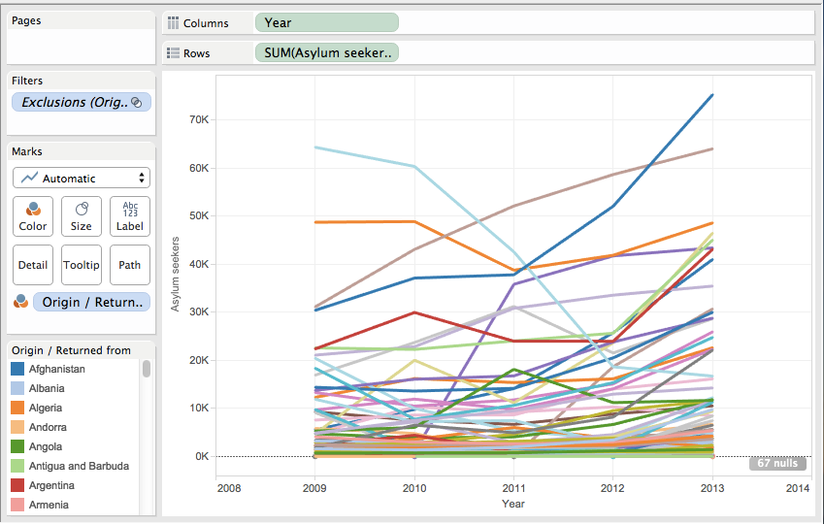
Multi-Line graph
Notes:
Multi-line graphs are useful for comparing quantities that change over time (or any other increasing quantity).

Slide 9
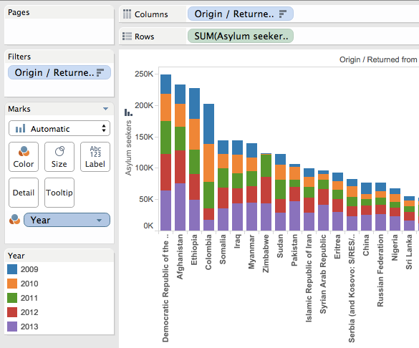
Stacked Column Chart
Notes:
Stacked column charts give you both totals (the size of each line) and relative contributions to each total (the colours). Sometimes (confusingly) these are called stacked barcharts.

Slide 10
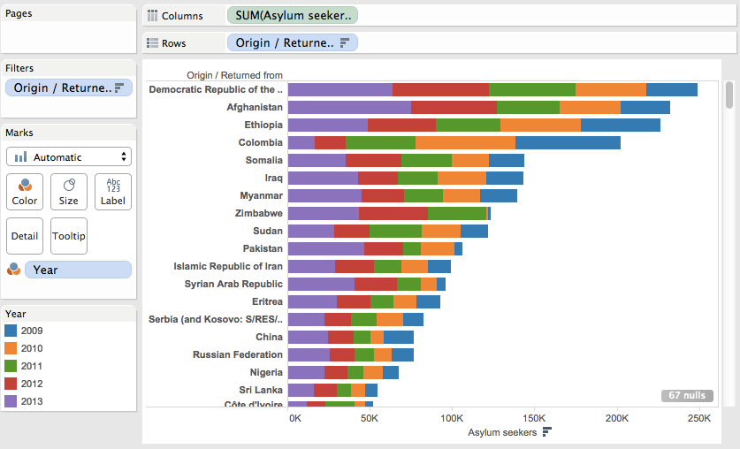
Stacked Barchart
Notes:
Barcharts are a 90-degree rotation of column charts. These can be very useful if you have a lot of bars (e.g. for the 300+ countries in the world) and want the user to be able to scroll up and down the chart to see them all.

Slide 11
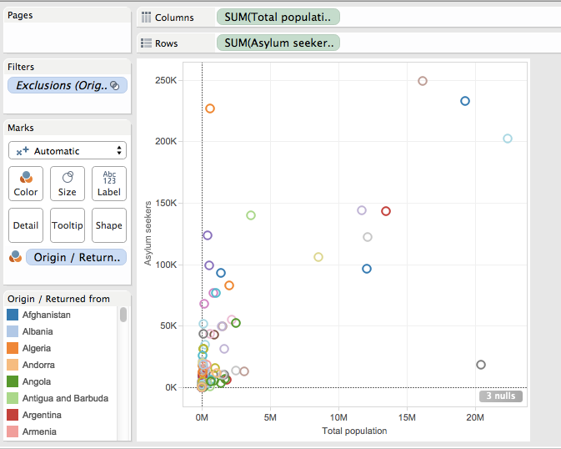
Scatterplot
Notes:
Scatterplots put a symbol at every combination of two (2-dimensional scatterplot) or three (3-dimensional scatterplot) values. These are useful for comparing pairs of features (e.g. population size vs refugee numbers) for a set of examples (e.g. for each country).
Simple scatterplots put a dot at each x,y value; more complex scatterplots use different colours, symbols or symbol sizes to show values of other features of interest (e.g. asylum seeker numbers, annual rainfall etc).

Slide 12
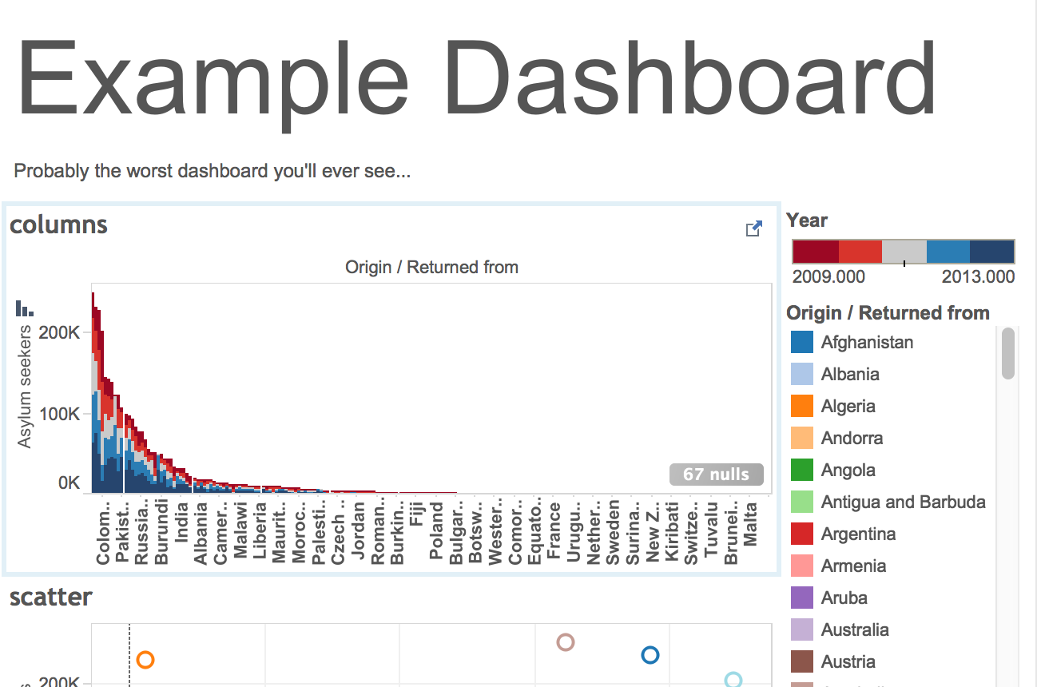
Dashboards
Notes:
You can put visualisations and text together in a dashboard. You can also link these visualisations, so that when you click on a point in one visualisation, data relevant to that point is shown in another.

Slide 13
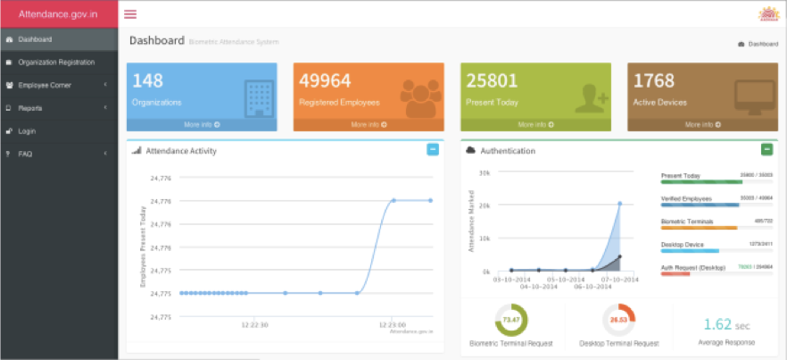
Dashboards
Notes:
This is india’s government employee attendance dashboard. If you look at the bottom of Tableau, there’s a dashboard button.

Slide 14
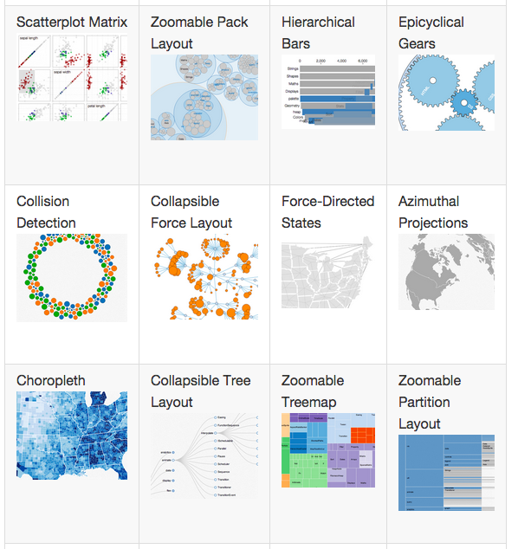
More visualisation types
Notes:
Other visualisation types you’ll see a lot include Chord diagram, Sankey diagram, Choropleth, symbol map.
[image: screenshot from D3 Gallery, https://github.com/d3/d3/wiki/Gallery]

Slide 15
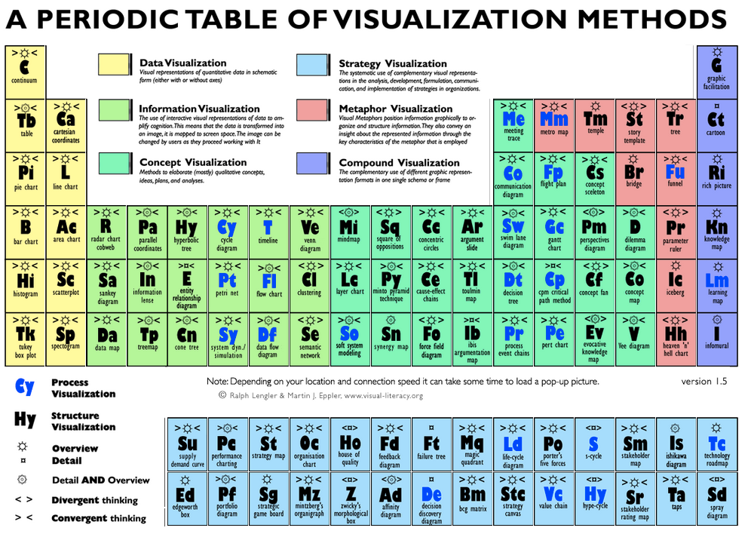
Name That Visualisation!
Notes:
When you start, it’s hard to know what different visualisation types are called, which makes looking up how to create them much more difficult. The visualisation periodic table helps here: hover over each box to see an example of that type of plot
[image: http://www.visual-literacy.org/periodic_table/periodic_table.html]

Slide 16
Common Visualisation Tools
Notes:
There are many visualisation tools available: this is just a set of more-common tools that are free or can be used offline.

Slide 17
Choosing a Visualisation Tool
What do you want to do?
  Standard visualisations, or something special?
  Inputs: files (e.g. CSV) or streaming data? Maps?
  Non-roman languages (Arabic, Mandarin etc)?
  Interactive or static?
Where do you want to do it?
  Online or offline?
Any other restrictions?
  Third-party visible or private?
  Free, cheap or expensive?
  Ease of use (and support!)
Notes:
Again, design. Not all tools are created equal: if you want to create offline Sankey diagrams in Arabic, the toolset available will be much smaller than for a static barplot in English. Here are some things you should think about when you choose a tool to use.

Slide 18
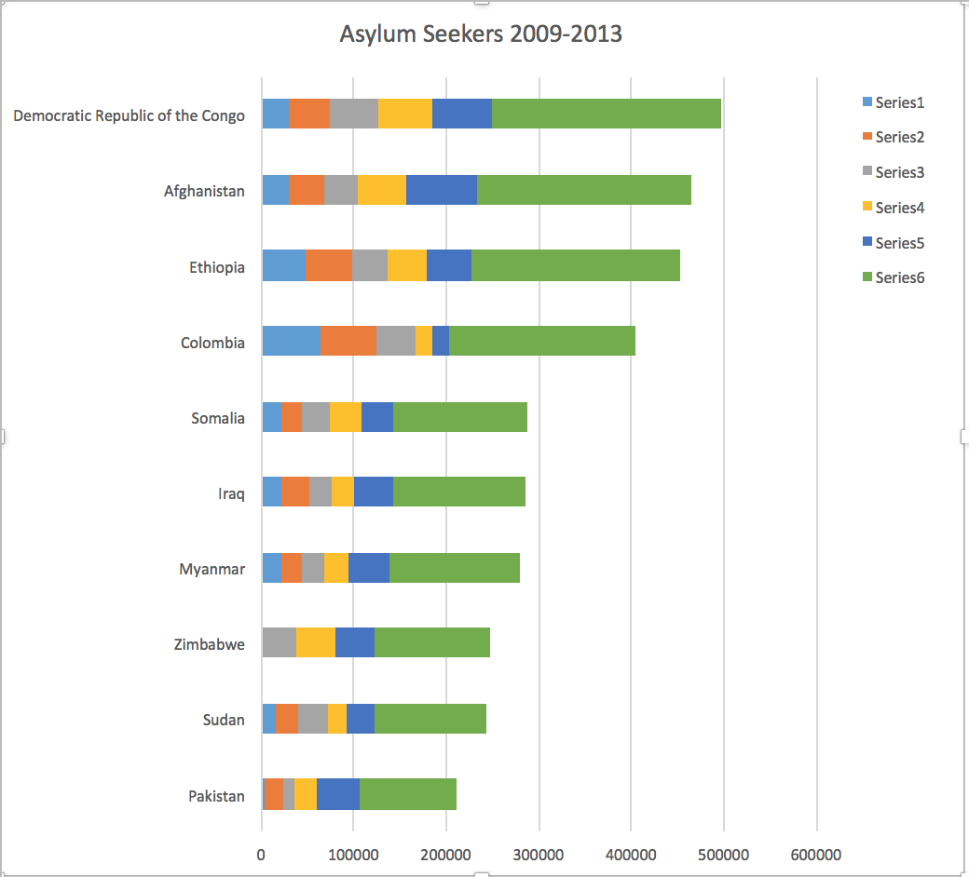
Excel
Limited set of visualisation types
Not interactive
Offline
Static
Not free
Relatively easy
Widely used
Notes:
To create this chart: copied the asylum seeker data into an excel spreadsheet. Created a pivot table from the data. Created a chart from the pivot table. Did lots of fussing around to get chart elements in the right place/ filtered. Still more fussing needed to get e.g. the legend right.

Slide 19
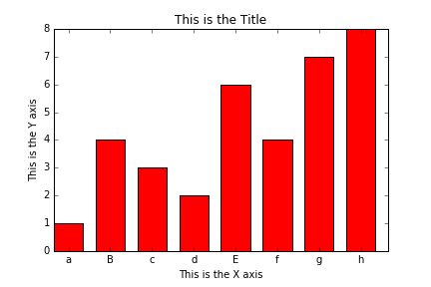
Matplotlib
Python visualisation library
Not interactive
Not the prettiest (but does have ways to make it prettier, e.g. Seaborn)
Good for quick-and-dirty views of data
Offline + Online
Free

Slide 20
Tableau
Tableau Public
Free
Interactive
Excel or text (CSV) import only
Public, and needs internet connection
Tableau Desktop
Not free (but free to students who ask)
Interactive
Range of import formats and datastore APIs
Private, and works offline

Slide 21
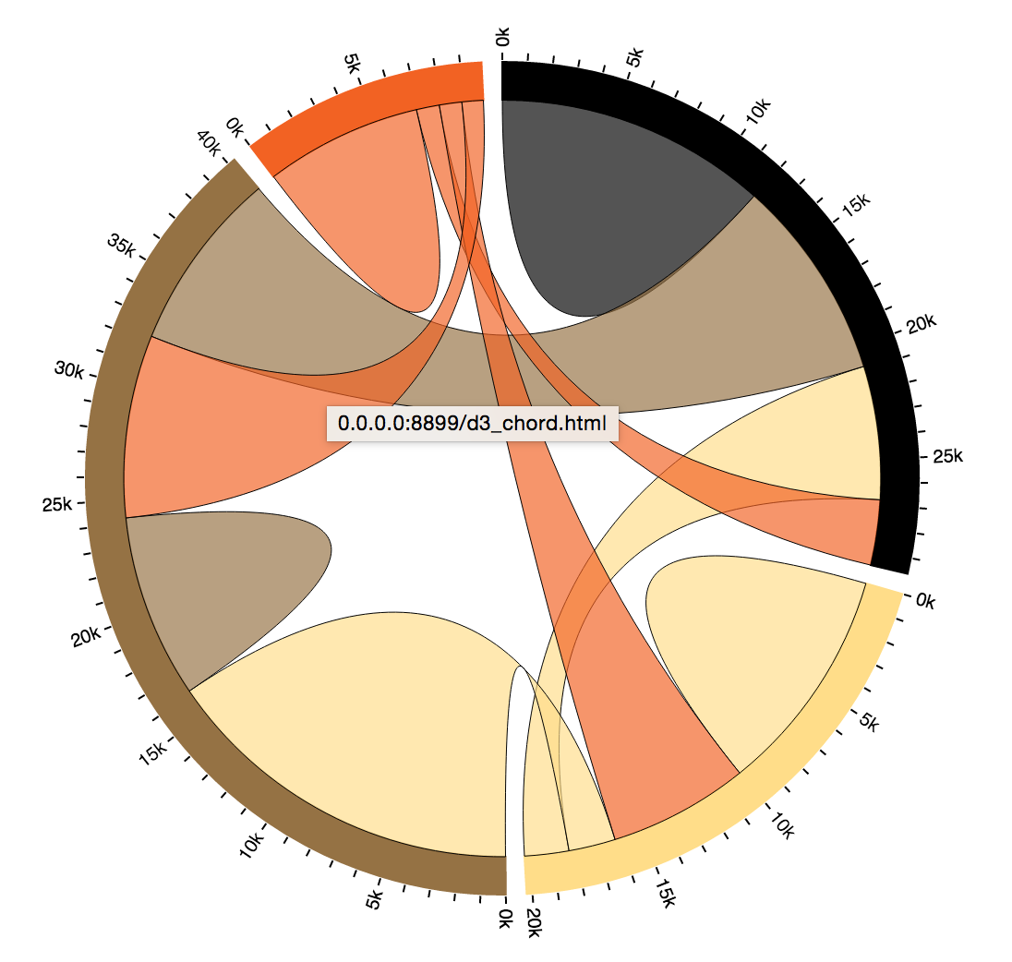
D3
Free
Interactive
Very very flexible = almost any diagram you want
Steep learning curve
Works offline

Slide 22

Other Common Tools
Piktochart
Google fusion tables
Ggplot
Highcharts
NVD3
Notes:
The image is one of the Piktochart templates. Infographics aren’t immediate outputs from python code, but can be very powerful.
[Image: screenshot from Piktochart.com]

Slide 23
Matplotlib exercise
Notes:
Let’s create a simple visualisation in matplotlib (the Python plotting library)

Slide 24
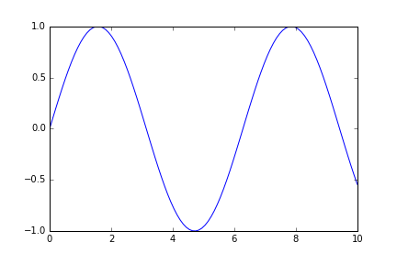
Exercise: draw a line chart in Matplotlib
%matplotlib inline # notebook only)
import matplotlib.pyplot as plt
import numpy as np
x = np.linspace(0, 10, 100)
y = np.sin(x)
plt.plot(x, y)
plt.show() # not notebook
Notes:
NB: You only need the %matplotlib inline in an ipython notebook.

Slide 25
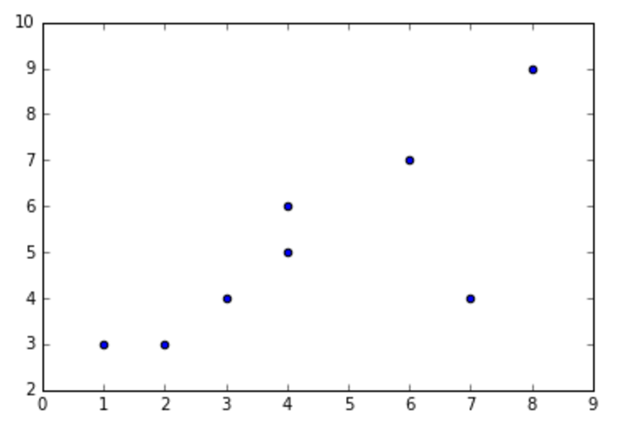
Exercise: draw a scatterplot
import matplotlib.pyplot as plt
import numpy as np
x = np.array([1,4,3,2,6,4,7,8])
y = np.array([3,5,4,3,7,6,4,9])
plt.scatter(x, y)

Slide 26
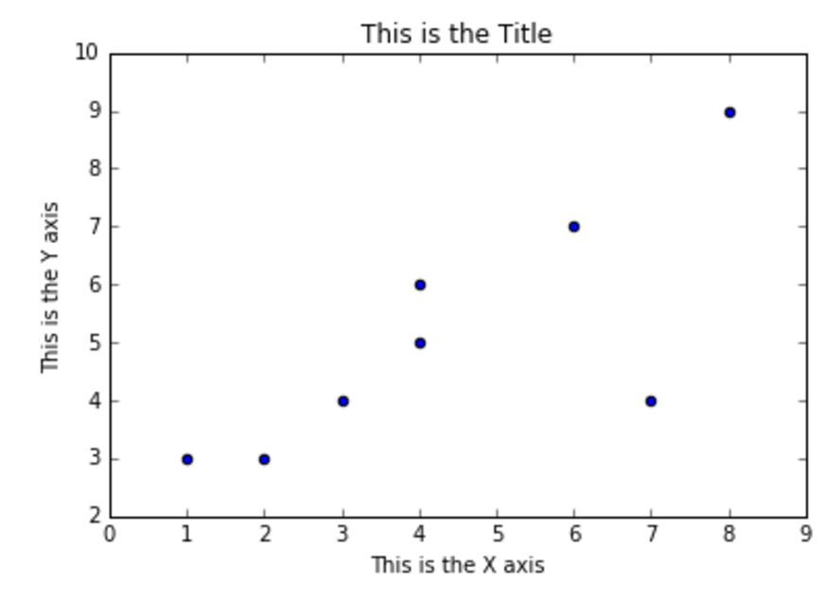
Add labels to your plot
fig, ax = plt.subplots()
plt.scatter(x, y)
ax.set_ylabel('This is the Y axis')
ax.set_xlabel('This is the X axis')
ax.set_title('This is the Title')
plt.show() # not notebook
S
Notes:
plt.subplots creates a plot on your drawing ‘canvas’. It’s what we usually use to create a group of plots. Here, we’re using it to get at the axes (ax) for this visualisation.

Slide 27
Tableau exercise
Notes:
Now let’s plot something in Tableau.

Slide 28
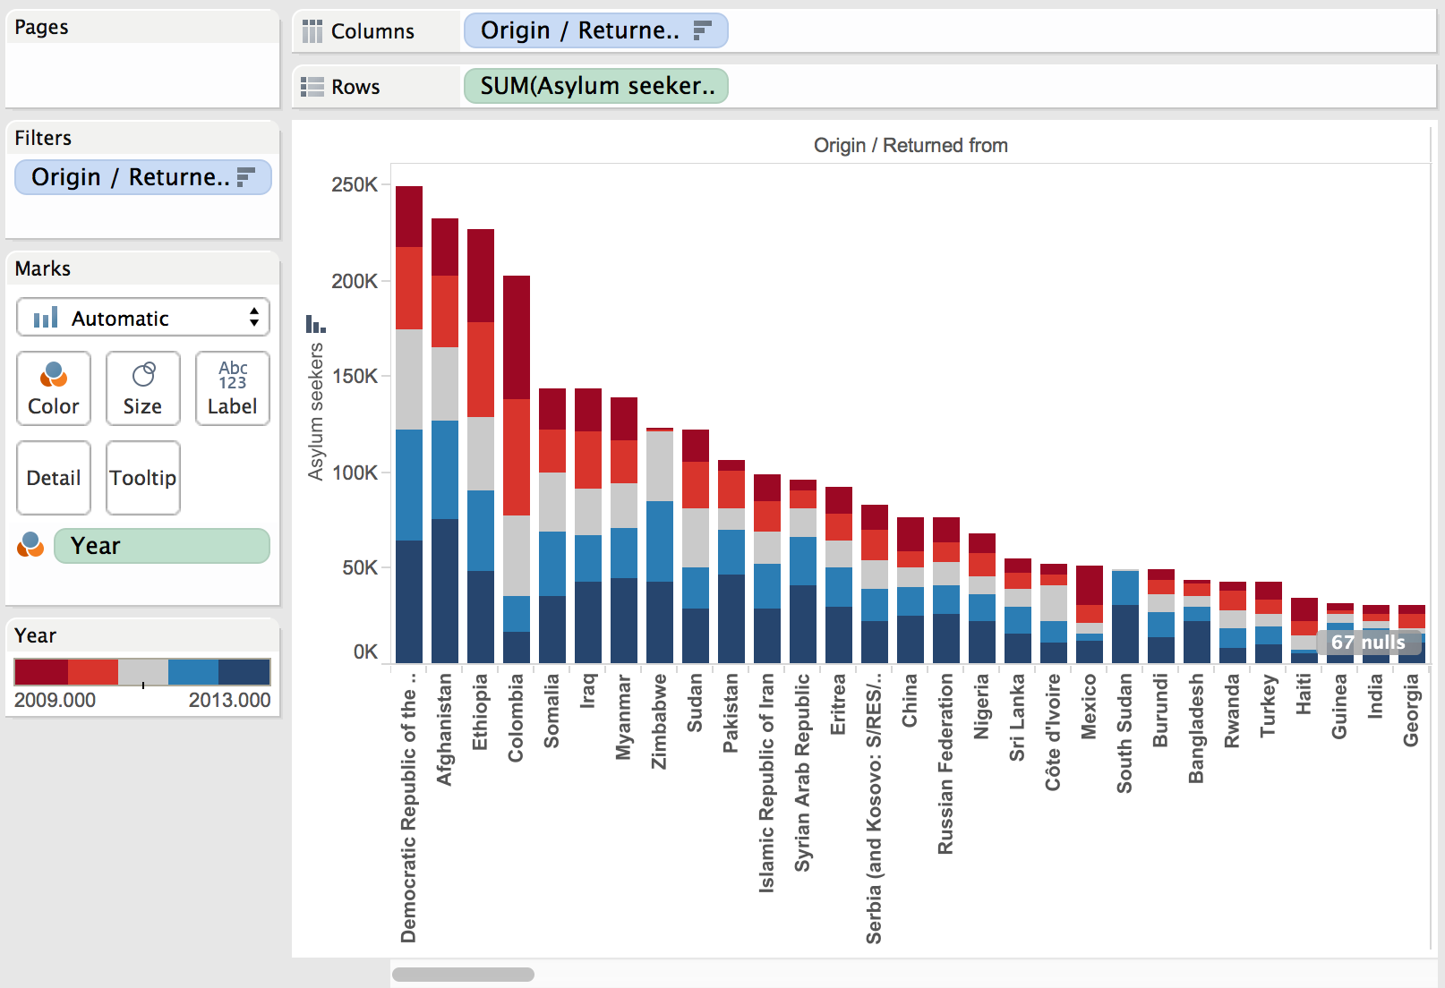
Exercise: Draw a stacked column chart in Tableau
Notes:
This is what we’re going to create, using the asylum-seeker dataset.

Slide 29
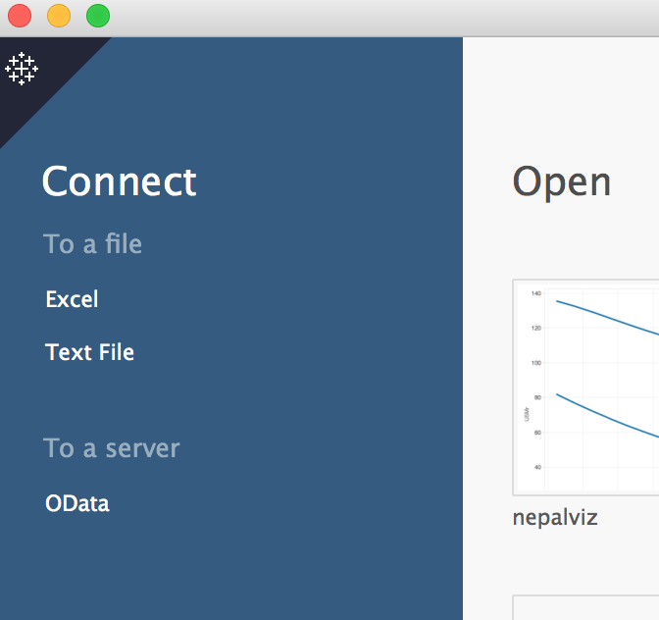
Do this: Import data into Tableau
Get a copy of example file “cleaned_popstats.csv”
Open Tableau Public (click on the executable)
Click on “Text File”
Select “cleaned_popstats.csv”, then “open”
Congratulations - you’ve got data into Tableau
Now click on “sheet 1” at the bottom of the page
Notes:
Data file is here is you get stuck: https://github.com/bodacea/datascienceforbeginners/blob/master/Notebooks/example_data/cleaned_popstats.csv

Slide 30
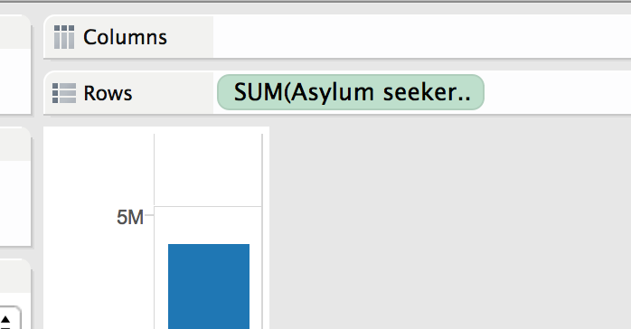
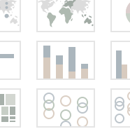
Do this: add rows
From sheet1:
You should see a “show me” box on the top RHS: click on it, then the thing that looks like a column chart (sigh: Tableau calls it “stacked bar”)
Drag “asylum seekers” from under “Measures” to the “rows” box
Notes:
Don’t panic when “asylum seekers” becomes “SUM(Asylum seekers)” in the Rows box. This is normal.

Slide 31
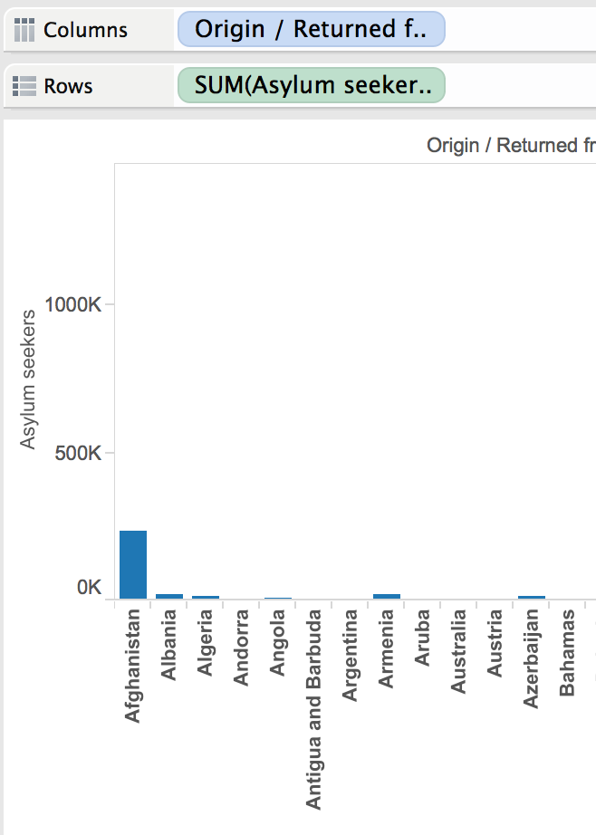
Do this: add columns
Drag “origin/ returned from” from under “dimensions” to the “columns” box
Right-click on “origin/returned from” in the “columns” box.
Click “sort…”
Click “descending”
Click “field”
Click “okay”
Notes:
At this point, you’re probably wondering why the columns are so small

Slide 32
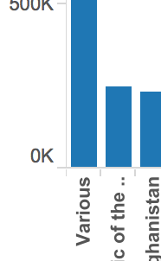
Do this: remove a column from the graph
Right-click on “various” in the graph.
Click “Exclude”
Watch the graph scale to the new biggest value (Democratic Republic of the Congo)
Notes:
Okay, “Various” is huge, and not helping the graph much. Let’s remove it.

Slide 33
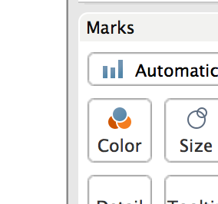
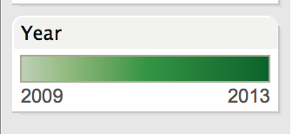
Do this: add colours
Drag “Year” to color (under “Marks”)
The green is okay, but not easy to read:
Click the little triangle that appears when you hover over the new “Year” colours box
Click “Edit colors”
Click “stepped color”
Click the bar under “Palette”; click “Red Blue Diverging” then “okay”
Notes:
The green is okay, but not easy to read; here’s how you get a set of different colours in your bars.

Slide 34
A stacked column chart in Tableau
Notes:
Also available at https://public.tableau.com/profile/publish/DS_session_example/Sheet1#!/publish-confirm

Slide 35
D3 and Beyond
Notes:
You’ve met matplotlib and tableau, but you also need to know about some of the more powerful visualisation tools. One of these is D3: it’s used widely, but takes a while to explain, so we’re jstu going to cover how to run a D3 file.
For more details on D3, look in my github account for an earlier course that included D3 (https://github.com/bodacea/datasciencecodingfordevelopment) – or better yet, get Scott Murray’s book on it (http://alignedleft.com/work/d3-book.

Slide 36
Drawing a Chord Diagram in D3: Online
Use the terminal window
cd to the directory containing file 4.3_d3_chord_online.html
In the terminal window, type:
python -m http.server 8899 &
Then go to http://0.0.0.0:8899/4.3_d3_chord_online.html in your browser
And hover your mouse over the circle edges...
(to exit, type control-c)
Notes:
This starts a webserver on your PC, that you can then go to and look at your D3 file in.
NB I changed the channel to 8899 because the standard (8888) clashes with the ipython notebook server.
Chord example is from http://bl.ocks.org/mbostock/4062006
NB: space in the filename will making your code crash; try to use e.g. underscores instead.

Slide 37
Drawing a Chord Diagram in D3: Offline
Copy your d3.js.zip file and the 4.4_d3_chord_offline.html file into a directory
Unzip d3.js.zip
In the directory your code is in, type:
python -m http.server 8899 &
Then go to http://0.0.0.0:8899/4.4_d3_chord_offline.html in your browser
And hover your mouse over the circle edges...
(to exit, type control-c)
Notes:
The difference between the two files is in where the D3 code comes from.
In the online version, the D3 code is at //d3js.org/d3.v3.min.js (the d3.v3.min.js file is a version of d3.js with all the whitespace and comments taken out to make it smaller);
In the offline version, the D3 code is on your pc, in file d3.js the d3 directory.
Bugz: you might get an error message saying “Address already in use”. This is bad and naughty, but to quickly fix it, try:
in the terminal window, type “ps -a”
Note the number at the left of the line that looks like “7064 ttys000 0:00.16 python -m http.server 8899”
type “kill -9 7064” (or whatever your number was).
Note: this is a very powerful command: make sure you’re using the right number, or you might accidentally shut down your machine…

Slide 38
That chord diagram
Notes:
And here’s what you should expect to see. Go ahead and click on the coloured edges of the circle…

Slide 39
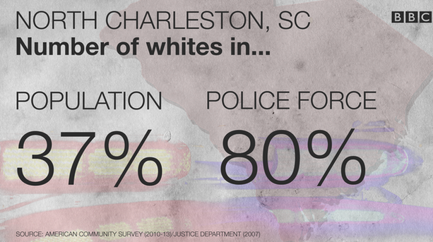
Communication doesn’t have to be complex
Notes:
Visualisations don’t have to be complex to be powerful: here, two numbers are left to speak for themselves.
[image: screenshot from news.bbc.co.uk]

Slide 40
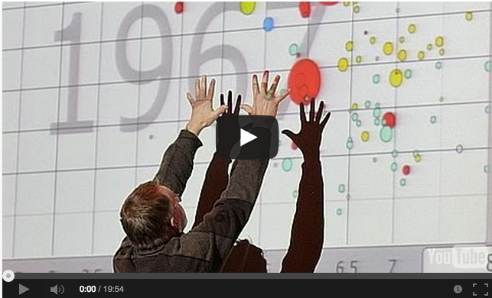
Communication doesn’t have to be “standard”
Notes:
Visualisations don’t have to be ‘standard’ either: an example of this is Hans Rosling’s videos of poverty changes over time.
[Image: Hans Rosling video; see https://www.youtube.com/watch?v=jbkSRLYSojo for more on how this was created]

Slide 41
Exercises

Slide 42
Exercise: Design your visuals
Use pen and paper (or post-its) to design visualisations and dashboards for your project
Use Tableau or Matplotlib to prototype these

